Slide 1
Module 3 Chapter 2: Deadlock

Slide 2
Contents
The Deadlock Problem
System model
deadlock characterization
Methods for Handling Deadlocks
deadlock prevention
Deadlock Avoidance
Deadlock Detection
Recovery from Deadlock

Slide 3
Objectives
To develop a description of deadlocks, which prevent sets of concurrent processes from completing their tasks.
To present a number of different methods for preventing or avoiding deadlocks in a computer system

Slide 4
The Deadlock Problem
A set of blocked processes each holding a resource and waiting to acquire a resource held by another process in the set
Example
System has 2 disk drives
P₁ and P₂ each hold one disk drive and each needs another one
Example
semaphores A and B, initialized to 1
P₀ P₁
wait (A); wait(B)
wait (B); wait(A)

Slide 5
Bridge Crossing Example
Traffic only in one direction
Each section of a bridge can be viewed as a resource
If a deadlock occurs, it can be resolved if one car backs up
preempt resources and rollback
Several cars may have to be backed up if a deadlock occurs
Starvation is possible
Note : Most OS do not prevent or deal with deadlocks

Slide 6
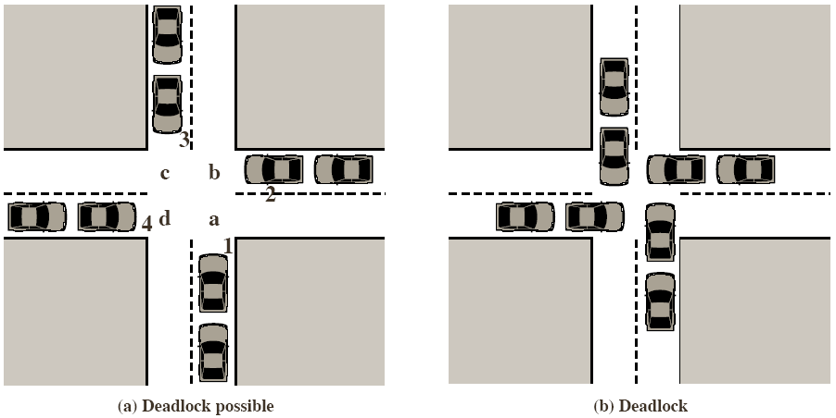
Deadlock Principles
A deadlock is a permanent blocking of a set of threads
a deadlock can happen while threads/processes are competing for system resources or communicating with each other
Illustration of a deadlock

Slide 7
System Model
Resource types R₁, R₂, . . ., R_{m}
CPU cycles, memory space, I/O devices
Each resource type R_{i} has W_{i} instances.
Each process utilizes a resource as follows:
request
use
release

Slide 8
Deadlock Characterization
Deadlock can arise if four conditions hold simultaneously.
Mutual exclusion: only one process at a time can use a resource
Hold and wait: a process holding at least one resource is waiting to acquire additional resources held by other processes
No preemption: a resource can be released only voluntarily by the process holding it, after that process has completed its task
Circular wait: there exists a set {P₀, P₁, …, P₀} of waiting processes such that P₀ is waiting for a resource that is held by P₁, P₁ is waiting for a resource that is held by
P₂, …, P_{n–1} is waiting for a resource that is held by P_{n}, and P₀ is waiting for a resource that is held by P₀.

Slide 9
NECESSARY CONDITIONS ALL of these four must happen simultaneously for a deadlock to occur:
Mutual exclusion
One or more than one resource must be held by a process in a non-sharable (exclusive) mode.
Hold and Wait
A process holds a resource while waiting for another resource.
No Preemption
There is only voluntary release of a resource - nobody else can make a process give up a resource.
Circular Wait
Process A waits for Process B waits for Process C .... waits for Process A.

Slide 10
Resource-Allocation Graph
A set of vertices V and a set of edges E.
V is partitioned into two types:
P = {P₁, P₂, …, P_{n}}, the set consisting of all the processes in the system
R = {R₁, R₂, …, R_{m}}, the set consisting of all resource types in the system
request edge :directed edge P₁ → R_{j}
assignment edge : directed edge R_{j} → P_{i}

Slide 11
Resource-Allocation Graph (Cont.)
Process
Resource Type with 4 instances
P_{i} requests instance of R_{j}
P_{i} is holding an instance of R_{j}
P_{i}
R_{j}
P_{i}
R_{j}

Slide 12
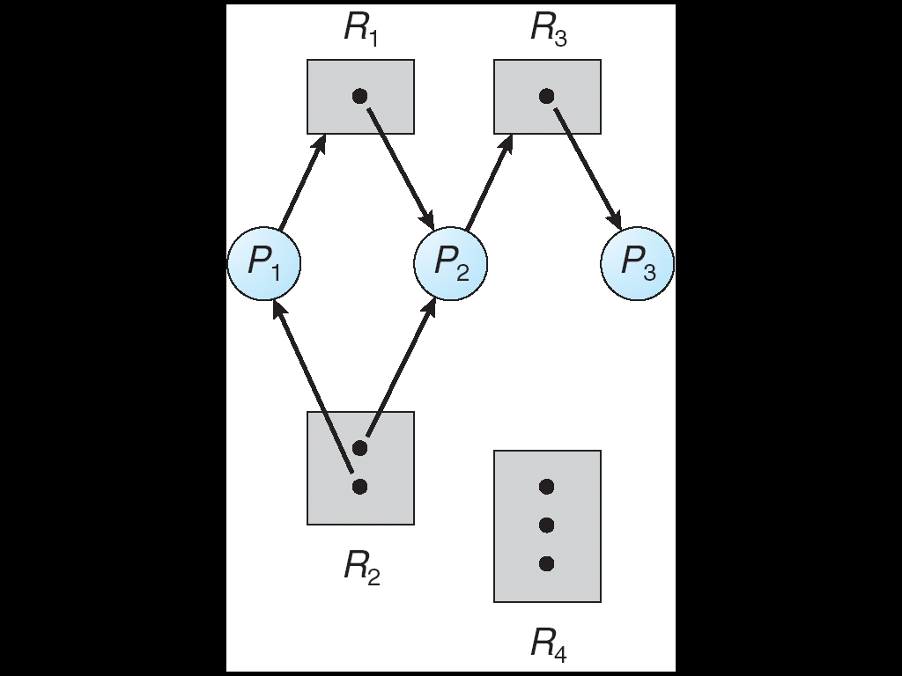
Example of a Resource Allocation Graph

Slide 13
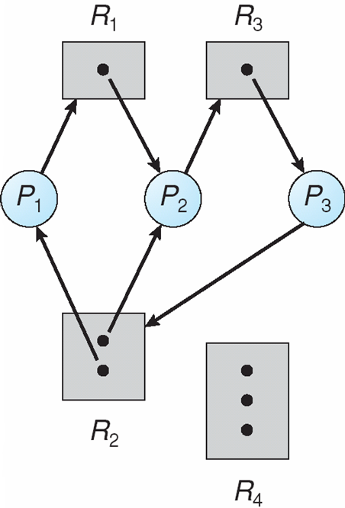
Resource Allocation Graph With A Deadlock
P1🡪 R1 🡪 P2 🡪 R3 🡪 P3 🡪 R2 🡪 P1
P2 🡪 R3 🡪 P3 🡪 R2 🡪 P2

Slide 14
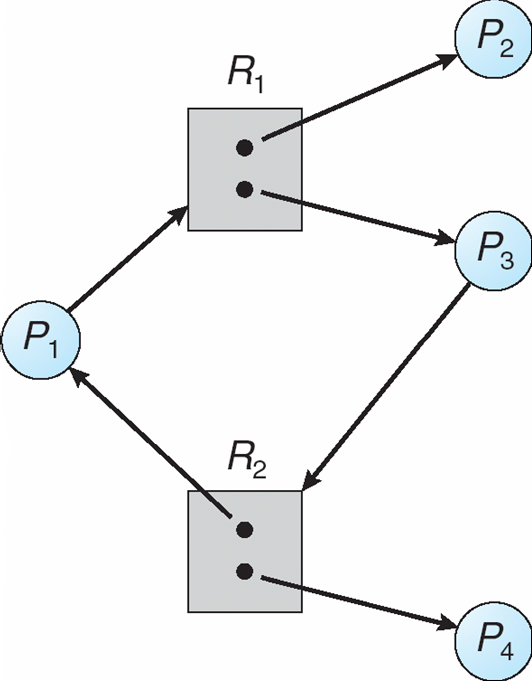
Graph With A Cycle But No Deadlock
P1🡪 R1 🡪 P3 🡪 R2 🡪 P1

Slide 15
Basic Facts
If graph contains no cycles ⇒ no deadlock
If graph contains a cycle ⇒
if only one instance per resource type, then deadlock
if several instances per resource type, possibility of deadlock

Slide 16
Methods for handling deadlocks
Ensure that the system will never enter a deadlock state.
Prevention: Prevent any one of the 4 conditions from happening.
Avoidance : Allow all deadlock conditions, but calculate cycles about to happen and stop dangerous operations.
Allow the system to enter a deadlock state and then
detect and
recover
Ignore the problem and pretend that deadlocks never occur in the system; used by most OS, including UNIX.

Slide 17
Deadlock Prevention
Mutual exclusion:
Hold for non-sharable resources ex: printer
not required for sharable resources
Can’t deny mutual exclusion condition
2. Hold and wait:
Collect all resources before execution🡪 resource utilization is low
Allow a process to request resources only when it has none 🡪 starvation possible

Slide 18
Deadlock Prevention
3. No preemption:
If a process that is holding some resources requests another resource that cannot be immediately allocated to it, then all resources currently being held are released.
Preempted resources are added to the list of resources for which the process is waiting.
Process will be restarted only when it can regain its old resources, as well as the new ones that it is requesting.
4. Circular wait:
impose a total ordering of all resource types,
each process requests resources in an increasing order

Slide 19
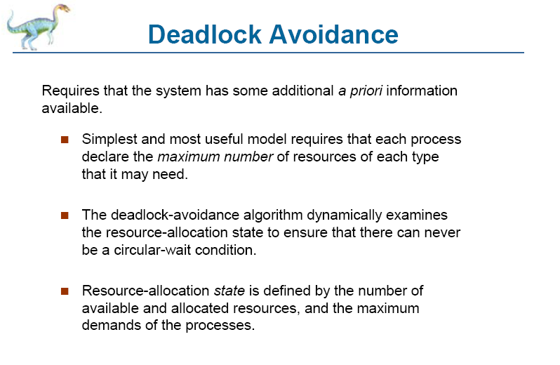
Deadlock Avoidance

Slide 20
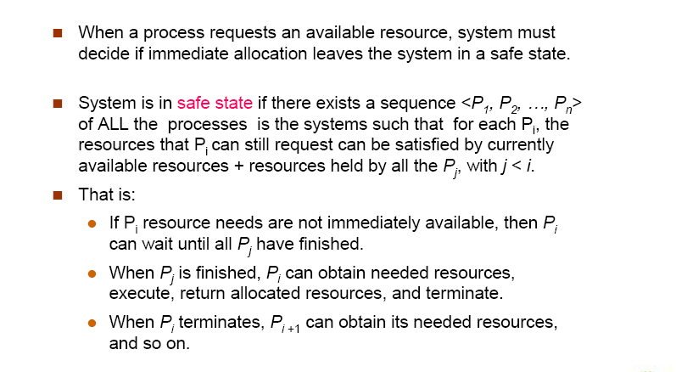
Safe State

Slide 21
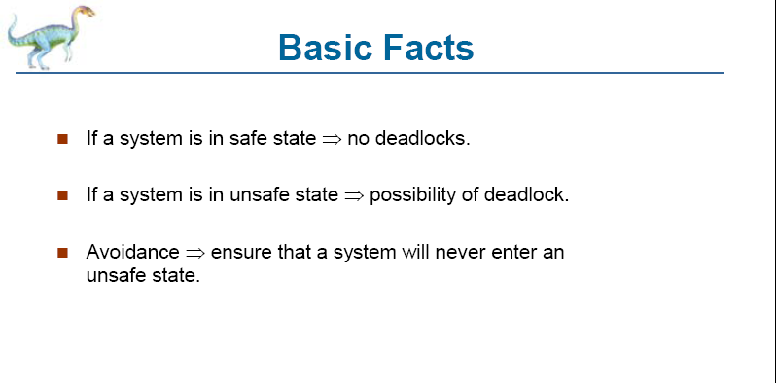
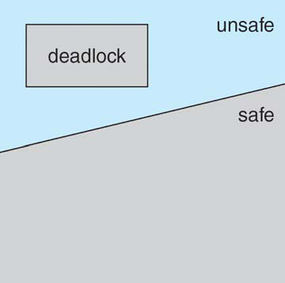
Basic facts

Slide 22
Avoidance algorithms
Single instance of a resource type 🡪 resource allocation graph algorithm
Multiple instances of a resource type 🡪 banker’s algorithm

Slide 23
Resource-Allocation Graph Scheme
Claim edge Pi 🡪 Rj ==>process Pj may request resource Rj;(-->).
Claim edge 🡪request edge when a process
requests a resource.
Request edge 🡪assignment edge when the resource is allocated to the process.
When a resource is released by a process, assignment edge reconverts to a claim edge.
Resources must be claimed a priori in the system.

Slide 24
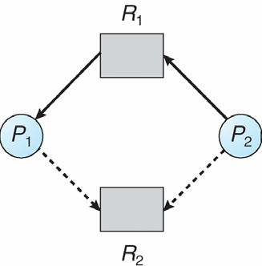
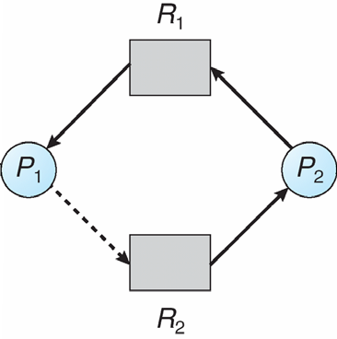
Resource-Allocation Graph
Unsafe state in resource-allocation graph

Slide 25
Resource-Allocation Graph Algorithm
Pi 🡪 Rj
The request can be granted only if converting the request edge to an assignment edge does not result in the formation of a cycle in the resource allocation graph

Slide 26
Banker’s Algorithm
Multiple instances.
Each process must a priori claim maximum use.
When a process requests a resource it may have to wait.
When a process gets all its resources it must return them in a finite amount of time.

Slide 27
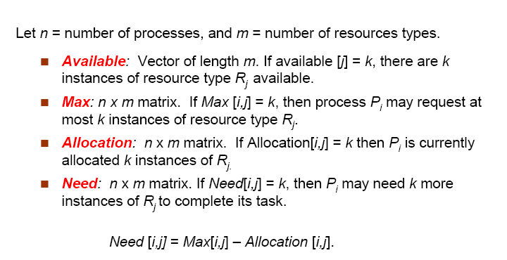
Data Structures for the Banker’s Algorithm

Slide 28
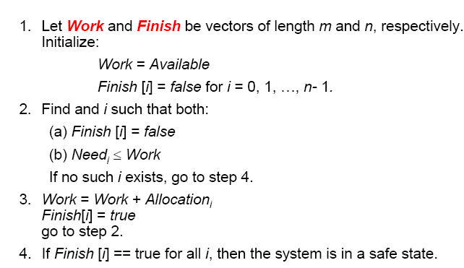
Safety Algorithm

Slide 29
Resource-Request Algorithm for Process Pi
If Request_{i} [j] = k then process Pi wants k instances of resource type Rj.
1. If Request_{i} ≤ Need_{i} go to step 2. else, raise error
condition, since process has exceeded its maximum claim.
2. If Request_{i} ≤ Available, go to step 3. Otherwise Pi must
wait, since resources are not available.
3. Pretend to allocate requested resources to Pi by modifying the state as follows:

Slide 30
Resource-Request Algorithm for Process Pi
Available = Available – Request;
Allocation_{i}= Allocation_{i} + Request_{i};
Need_{i} = Need_{i} – Request_{i};
If safe ==> resources are allocated to Pi.
If unsafe==> Pi must wait, and the old resource-allocation state is restored

Slide 31
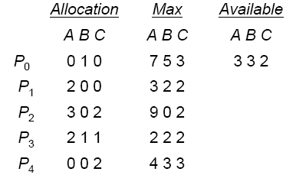
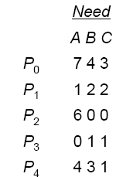
Example of Banker’s Algorithm
5 processes P0 … P4;
3 resource types: A (10 instances), B (5), and C (7)
Snapshot at time T0:
System is in safe state -- sequence < P1, P3, P4, P2, P0>

Slide 32
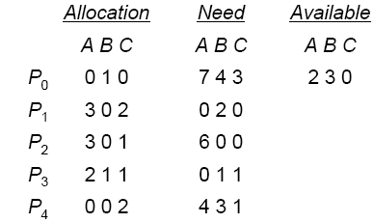
Example: P1 Request (1,0,2)
Check that Request ≤ Available (that is, (1,0,2) ≤ (3,3,2) ==> true.
< P1, P3, P4, P0, P2> satisfies safety requirement.
Can request for (3,3,0) by P4 be granted?
Can request for (0,2,0) by P0 be granted?

Slide 33
Deadlock Detection
Allow system to enter deadlock state
Detection algorithm
Recovery scheme
Single instance
Several instances

Slide 34
Single Instance of Each Resource Type
Maintain wait-for graph
Nodes are processes.
Pi 🡪 Pj if Pi is waiting for Pj.
Periodically invoke an algorithm that searches for a cycle in the graph. If there is a cycle, there exists a deadlock.

Slide 35
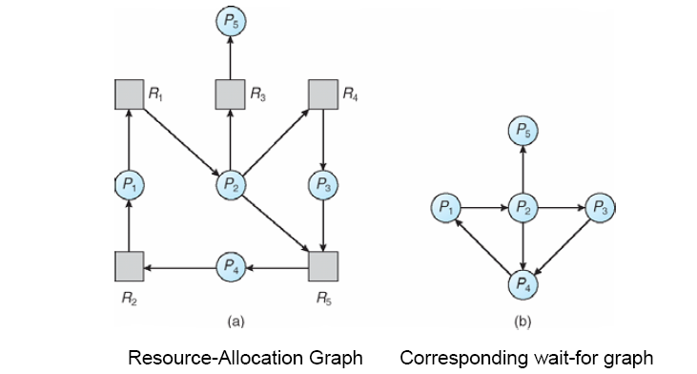
Resource allocation Graph and Wait-for Graph

Slide 36
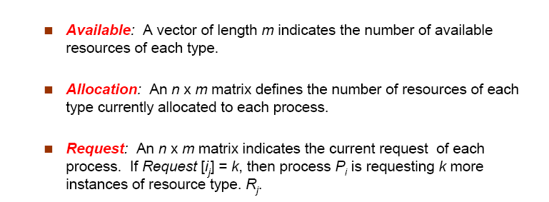
Several Instances of a Resource Type

Slide 37
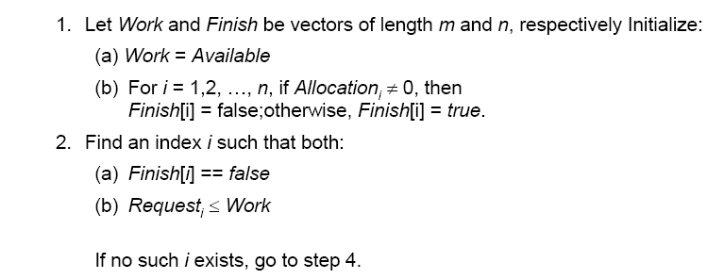
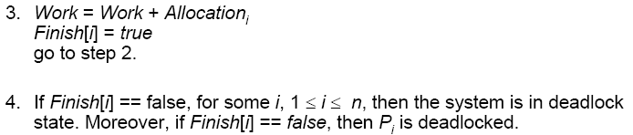
Detection Algorithm

Slide 38
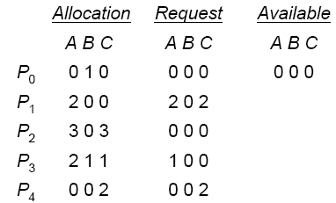
Example of Detection Algorithm
5 processes P0 … P4;
3 resource types: A (7 instances), B (2), and C (6)
Snapshot at time T0:
Sequence <P0, P2, P3, P1, P4>

Slide 39
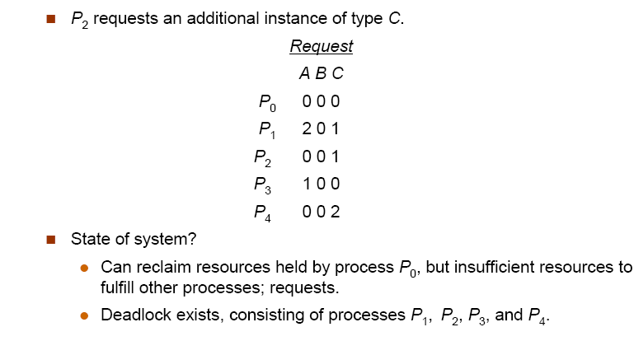
Example (Cont.)

Slide 40
Detection-Algorithm Usage
When, and how often, to invoke depends on:
How often a deadlock is likely to occur?
How many processes will need to be rolled back?
one for each disjoint cycle
If detection algorithm is invoked arbitrarily, there may be many cycles in the resource graph and so we would not be able to tell which of the many deadlocked processes “caused” the deadlock

Slide 41
Recovery from Deadlock
Process Termination
Resource Preemption

Slide 42
Process Termination
Abort all deadlocked processes.
Abort one process at a time until the deadlock cycle is eliminated.
In which order should we choose to abort?
what the priority of the process is
How long process has computed, and how much longer to completion.
how many & what type of resources the process has used
How many more resources process needs to complete
How many processes will need to be terminated
Is process interactive or batch?

Slide 43
Resource Preemption
Selecting a victim – minimize cost.
Rollback – return to some safe state, restart process for that state.
Starvation – same process may always be picked as victim, include number of rollback in cost factor.

Slide 44
Thank You

